Slide 1

Vndr
Graham Miller
Founder of Vndr.co

Slide 2
Background
A multi-channel selling platform to cross-list products to many marketplaces.
The idea sparked from a friend who spent countless hours uploading products manually to each platform.
The project is intended for vintage clothing sellers who upload their products manually to apps such as - Poshmark, Depop, and Mercari Marketplace.
Notes:
Vndr is being undertaken as a multi-channel selling platform to cross-list products to marketplaces that haven’t been used as a 3rd party service. The idea sparked from my friend who spent a countless number of hours uploading products manually to each service. The project is intended for vintage clothing sellers, like my friend who would like to grow their customer-base by having products on selling apps such as - Poshmark, Depop, and Mercari Marketplace. Normally, users will have to upload their products manually to each app, and by automating the process, it’ll allow users to focus more on the important parts of their growing business.

Slide 3
Benefits
Cross-post products all in one go without having to edit them all.
Save time uploading products and grant your customers with more leisure time.
Focus more on the important parts of their growing business.
Manage your inventory and see which products are uploaded to the channels
Increase of sales and customer outreach.
Improved security of your account (token/credentials saved on device rather online)
Notes:
With its’ modern dashboard, users of the app can sell on multiple platforms by using multi-upload tasks, and possibly be led to an increase of sales and an outreach of customers who love their products. The whole goal is to maximize the user’s sales and grant them more leisure time. Auth tokens / login credentials will be stored on the device. For improved security they will not be stored in the cloud. Reply to all customers while being on-app.

Slide 4
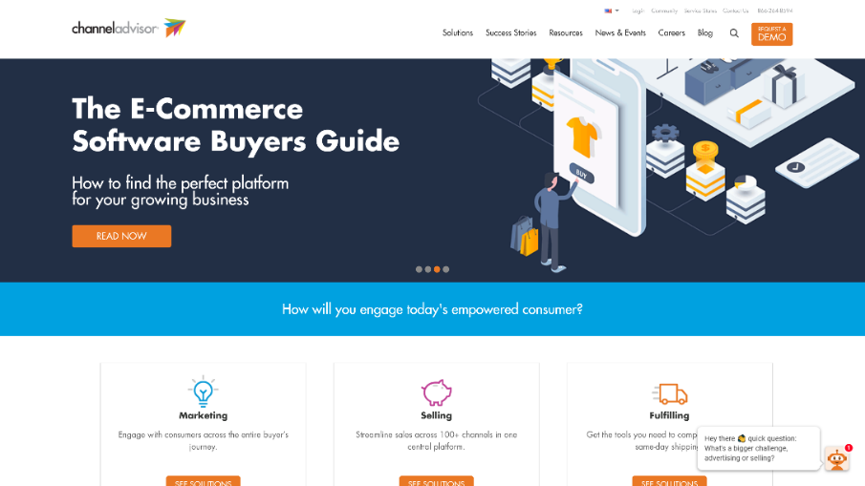
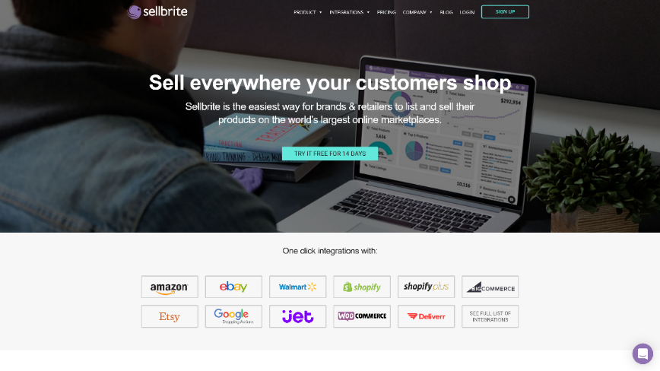
Differences Between Similar applications
Vndr
SellBrite & ChannelAdvisor
Mobility (Use on the go)
Platforms include – Poshmark, Mercari, and Depop
Automatic suggestions for brands, sizes, and categories.

Slide 5
Key features
Connect multiple channels to a particular platform
Toggle channels from uploading products
Product suggestions for size, category, and brand once product is saved and ready to be uploaded.
Inventory management with synchronized deleting of products across platforms
Notifications and automatic removal of sold products
Notes:
Multi-channel uploading to Poshmark, Depop, and Mercari Marketplace
Automatic data conversion for sizes, categories, brands, etc.
Inventory management, with synchronized editing & deleting of products across platforms
Notifications and automatic removal of sold products
Support chat-box of each platform to reply at user refunds or customer support
Toggleable buttons to disable the platform from uploading products

Slide 6
Project Proposal

